Slide 1
Date Night App
Terence Dawson, Paul Frazier, GEWELLE ROSS

Slide 2

Have you ever been annoyed that you can’t figure out what to do for a date night?

Slide 3
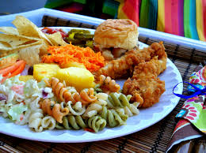

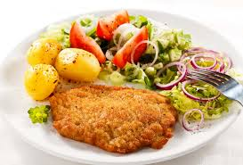
Or even for something simple as what to eat for dinner?

Slide 4
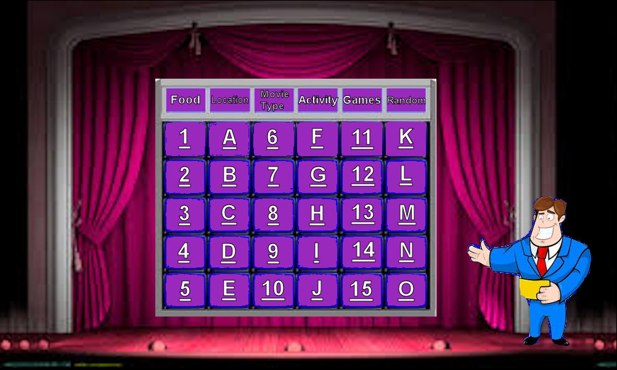
Let the Date Night app do the work for you!

Slide 5


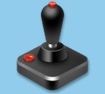


This app is broken down into 6 major categories in which users can select from individually for fun date suggestions, activities or locations. Also if they really want to spice things up they can chain a few of the categories together to take things over the top for a date you will never forget!!
Food
Games
Location
Activities
Movie type
Random

Slide 6
The 6 categories each include sub categories to give the users a large range of variety or selection to spice things up a bit more and get you out of the everyday normal. Ex...Food category consist of these sub categories
Italian
Indian
American
Latin
Oriental

Slide 7

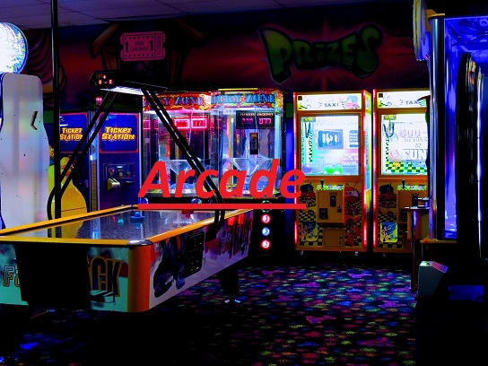


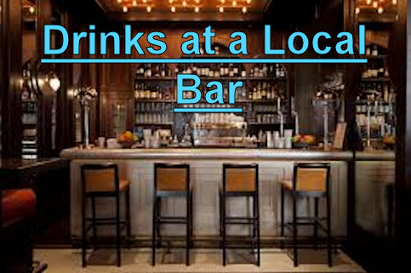
Or like this ..

Slide 8
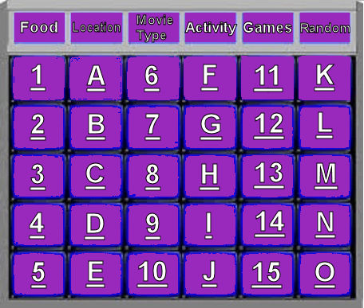
Key Features
Interactive
Sound Effects
6 Different Categories and 30 selections to choose from

Slide 9
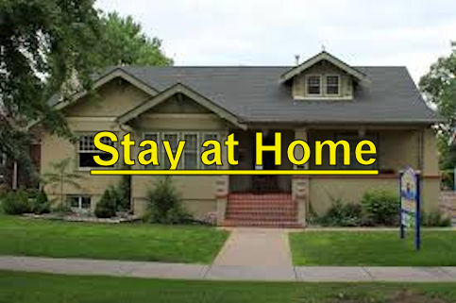
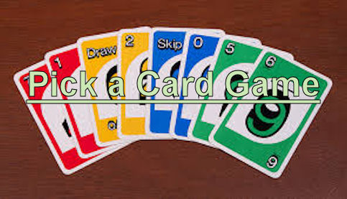
So depending or your budget and time, and of course the luck of the bored users can find themselves quite happy and content with this . .

Slide 10

We cant wait for the world to dive into this new date simulator the we present to you called. . . Date Night App!!!
Designed, produced, and edited by: Terence Dawson, Paul Frazier, GEWELLE ROSS

